Slide 1

Capstone Project
Battle of the Neighborhoods - Seattle

Slide 2
Best neighborhoods in Seattle to live with a dog
When choosing a residence with a dog, location is an important decision
The optimal location will have the most pet services and pet stores nearby
Having the option of both convenience and selection will give the best options for healthy pets.

Slide 3
Data and cleaning
The data on Seattle neighborhoods will be obtained from Wikipedia:
https://en.wikipedia.org/wiki/List_of_neighborhoods_in_Seattle
The neighborhoods dataset will be cleaned using the pandas library and the neighborhood geolocation data will be obtained by using the Geopy Nominatim service to request and append the geolocation data
The original neighborhood dataset had 127 neighborhoods listed and was dropped down to 100 neighborhoods for the neighborhoods that were too similar or not obtainable through the Geopy service.

Slide 4
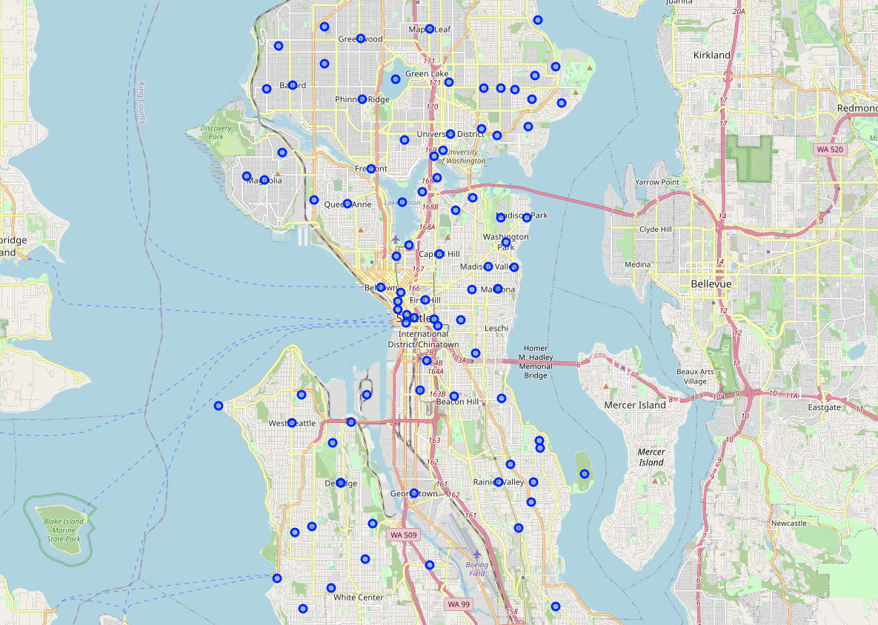
Seattle Neighborhoods

Slide 5
Venue Data
Venue data for each neighborhood was obtained through the Foursquare API and resulted in a dataset of 2434 rows by 7 columns.
From the venue data, it was determined that there are 299 unique venue categories in this dataset, however we are only looking for data related to pet stores and pet services. The addition of parks was considered, but since theme park venues are also included with that condition it was decided to be left out.
Of the pet venues that were isolated, there were 34 venues that matched the criteria in Seattle
One hot encoding was performed on the dataset to get it ready for KMeans Clustering

Slide 6

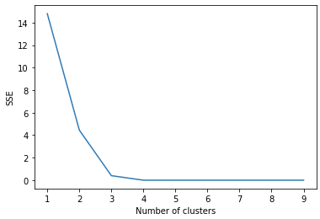
Elbow Curve for Cluster Number

Slide 7
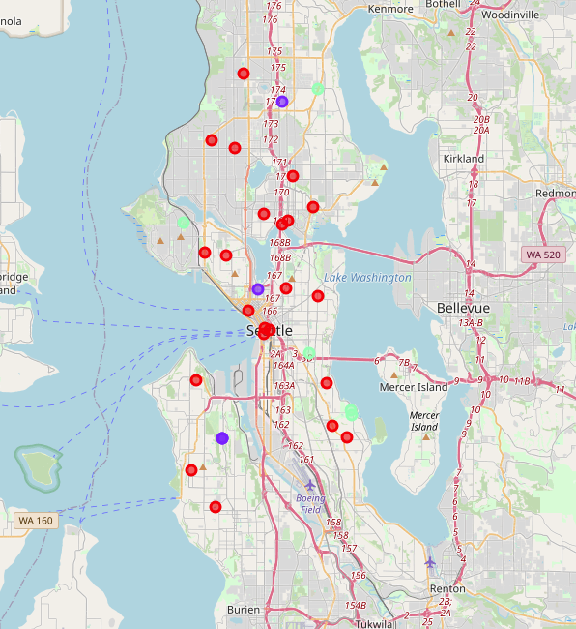
Resultant Clusters

Slide 8
Conclusion
Due to the cluster densities and venue availabilities, Downtown Seattle and the University District area were decidedly good locations for pet related venues that would offer both convenience and availability of selection for pet owners.
Following that, the Capital Hill neighborhood was also a good choice due to the parks in proximity as well as the number of available pet related venues

